Slide 1


LESSON 1
Music in care
• Lesson 1 - Introduction to music in care

Slide 2

CONTENT LESSON:
  Why this lesson?
  Explanation of lesson
  Assignments 1 and 2

Slide 3
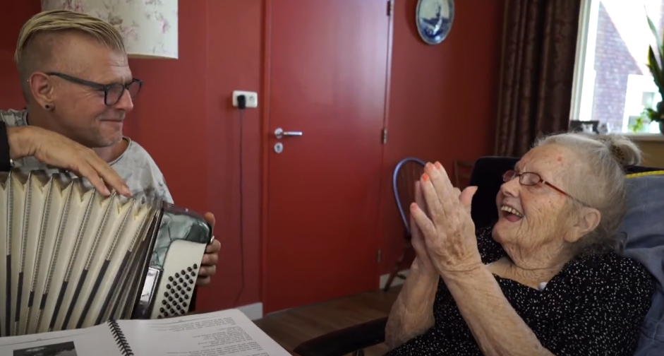
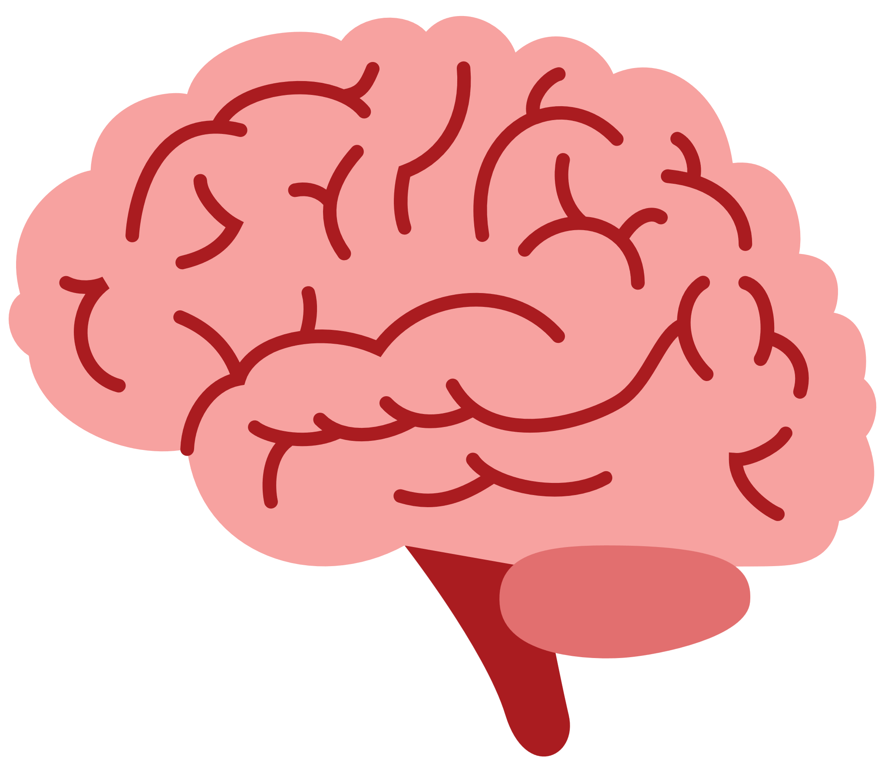

WHY THIS MODULE ?
We are increasingly discovering that music has a very positive effect on the brain.
Such a positive effect that even brains severely affected by a disease like Alzheimer’s can be reactivated for a short period: https://www.youtube.com/watch?v=ci2lBpOXncc

Slide 4

HENRI (ALIVE INSIDE)
https://www.youtube.com/watch?v=UlWBmUUutL0

Slide 5

EXPLANATION LESSON
Based on the upcoming lessons, you will have knowledge of:
  The effect of music on the brain
  Musical activities that you can implement
  Working systematically and applying (musical) activities
Review study guide

Slide 6

EXPERIENCES?

Slide 7
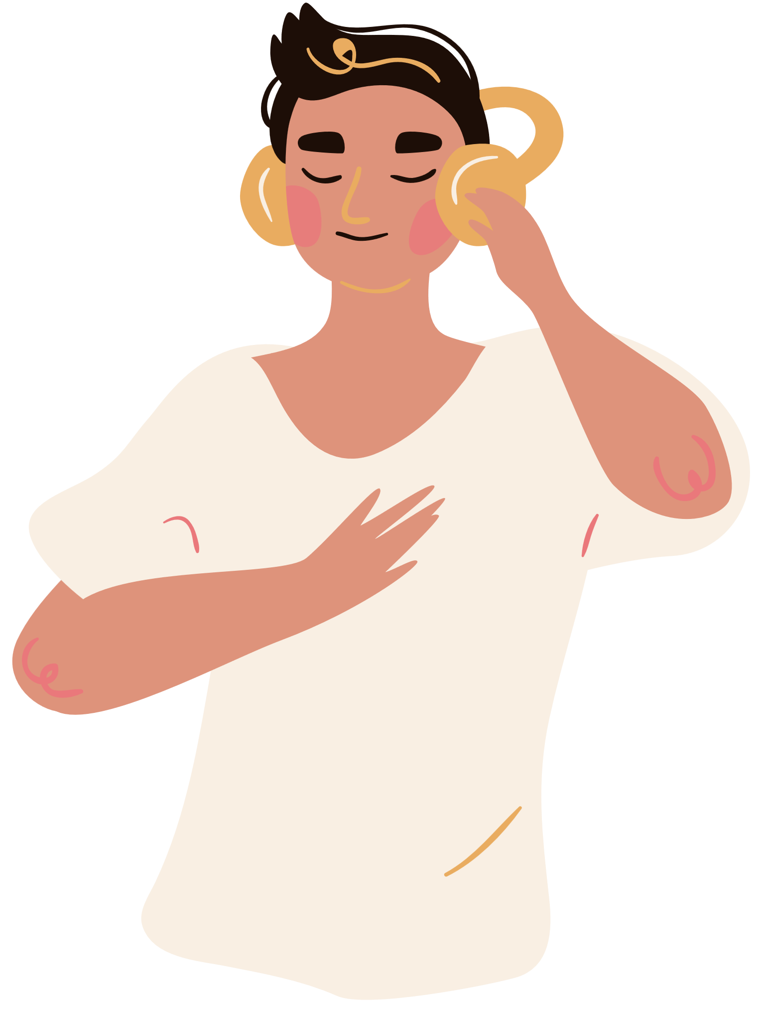

LISTEN TO THE MUSIC:
  What is happening?
  What did you experience?
  Do you recognise that music can evoke emotions?

Slide 8


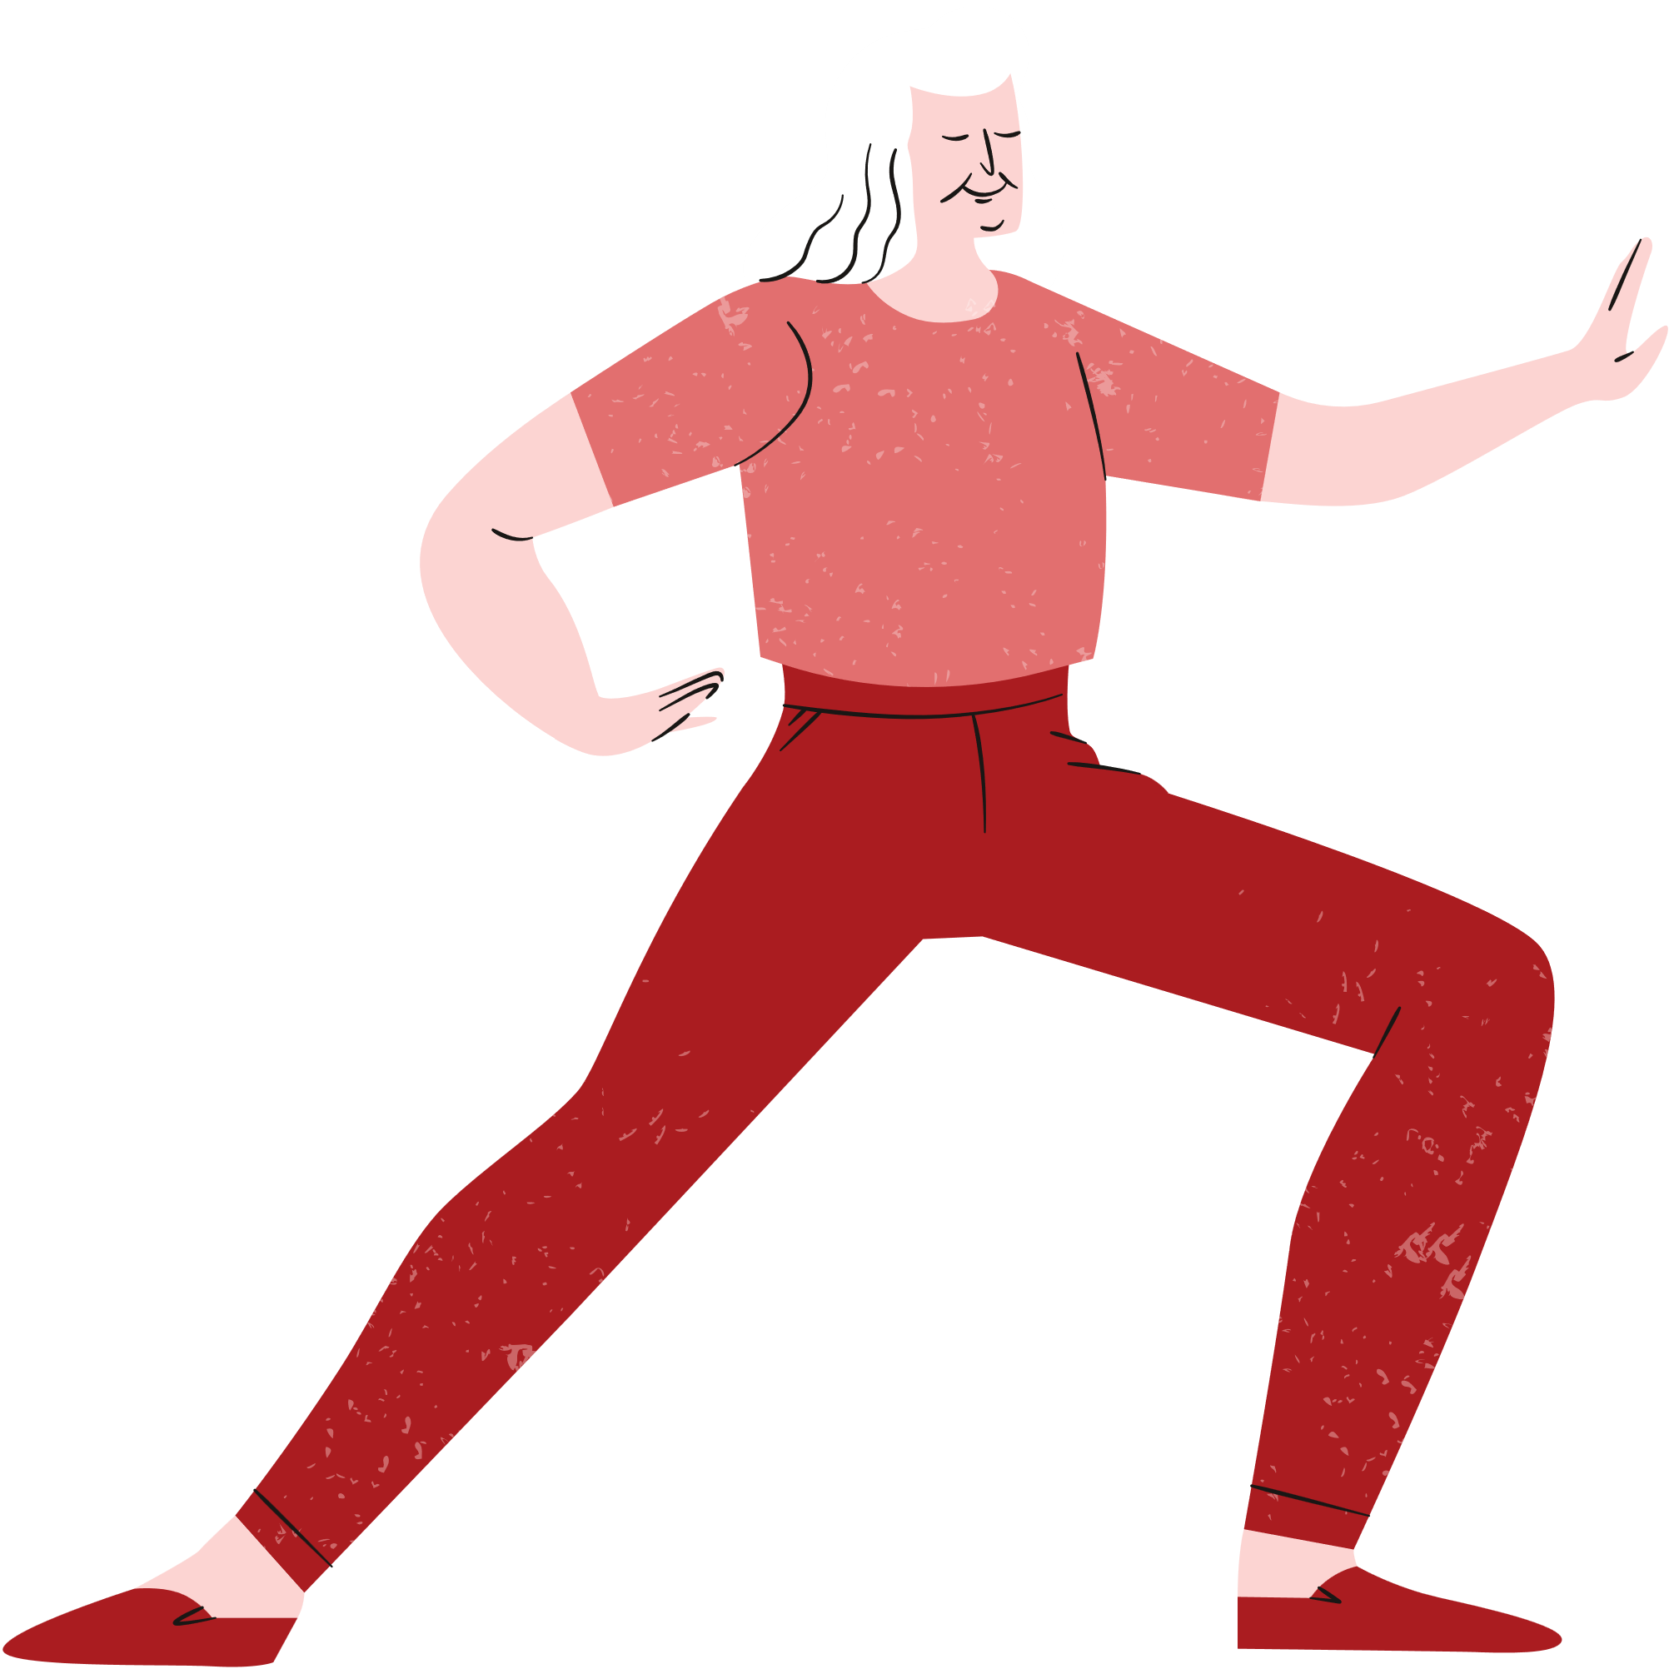
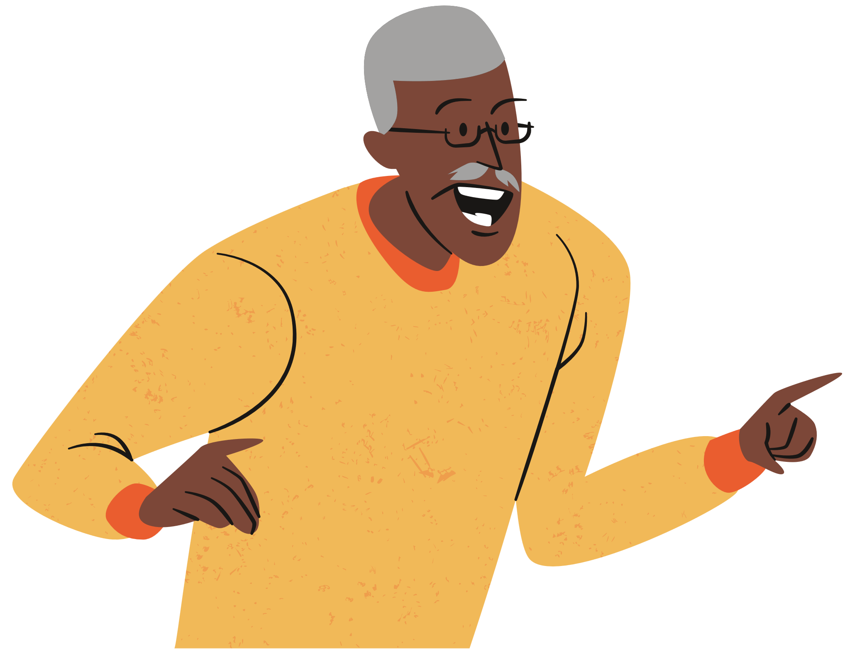
ASSIGNMENT 1 - WHAT DOES MUSIC DO TO YOU?
Music can make you feel really good, help you relax, make you active, fall in love or even get angry.
Music often activates your emotions.
Create a poster on one A4 sheet using Word or Canva. In this poster, include different music styles and the emotions you feel with this music.

Slide 9





ASSIGNMENT 2 - MUSICAL STYLES
There are many different music genres, such as Latin or Rock. These genres can often be subdivided into various music styles.
Research the different music genres and styles on the internet and create a logical overview of them. You don’t need to include all styles; choose a few that you are familiar with.

Slide 10






EVALUATION:
How did you experience this first lesson?

