Slide 1


LESSON 2
Music in care
  Lesson 2 - Music and the brain

Slide 2

EVALUATION OF PREVIOUS LESSON
  How did assignment 1 and 2 go? Is everything finished?

Slide 3

In assignment 1, which music style surprised you? (Did you discover a new style?)

Slide 4
Who wants to share the poster of assignment 2 and share something about it?

Slide 5

RECOGNISE EMOTIONS:
Recognising your caregiver's emotions is not always easy.
This may be related to disease states such as Parkinson's and dementia.
  It turns out there are broadly six emotions that we encounter all over the world.
  Can you recognise them all on the next Slide?

Slide 6
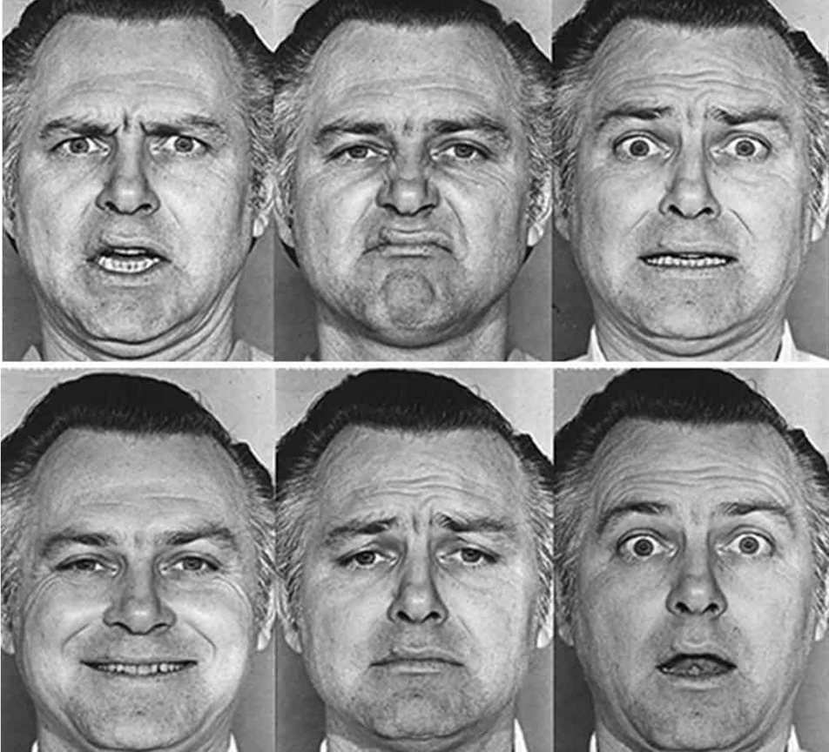
RECOGNISE EMOTIONS:
  What emotions do you think you see?
Write down all 6 on a note.
The answer from top left to bottom right is: anger, disgust, fear, joy, sadness and surprise.

Slide 7

ASSIGNMENT 1 AND 2

Slide 8

ASSIGNMENT 1 AND 2 MUSIC AND THE BRAIN
Assignment 1:
Why do you start moving almost automatically when you hear music? Why can music therapy solve certain brain problems?
Complete assignment 1 after reading the article.
The article can be found in the assignments.

Slide 9

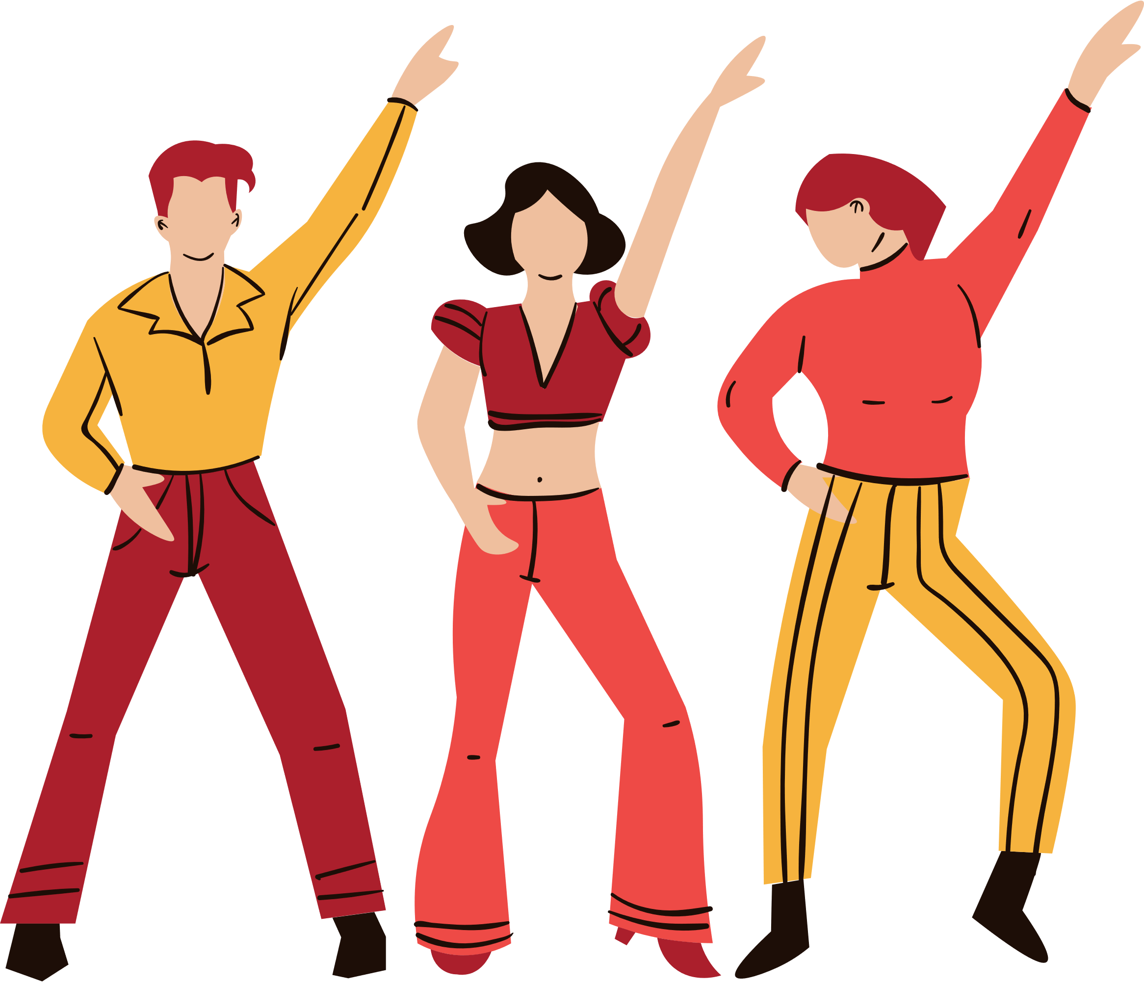
ASSIGNMENT 1 AND 2 MUSIC AND THE BRAIN
Assignment 2:
Why do you start moving almost automatically when you hear music? Why can music therapy solve certain brain problems?
Watch the following film and then complete assignment 2
https://www.youtube.com/watch?v=9Kq3rwjMxTE
TIP
There are 5 parts to Erik Scherder's documentary.
For the assignment, you only need to watch episode 2, but the other episodes are also well worth watching, especially episode 5.

Slide 10

ENERGIZER:
  Between assignments.
  Example of body percussion: click HERE
  Get started with body percussion: click HERE

Slide 11
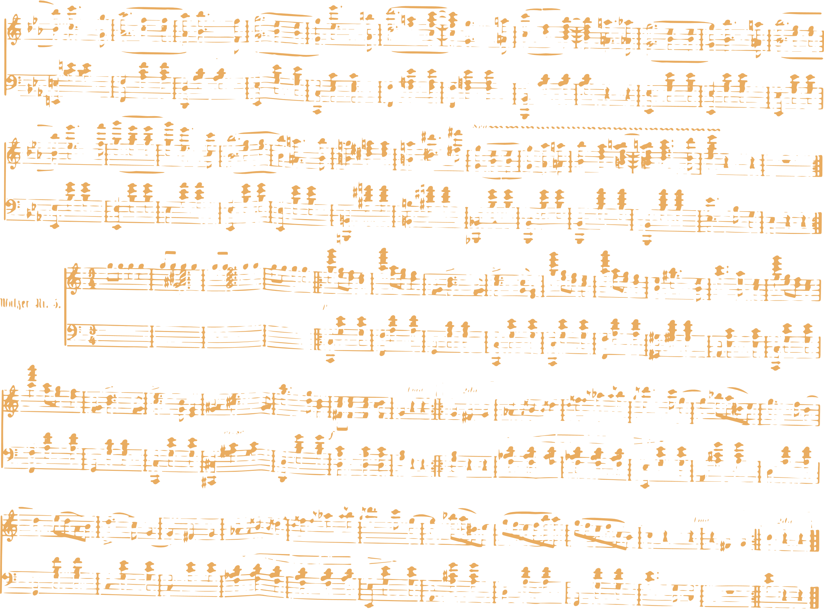





ASSIGNMENTS:
For this lesson, make assignments 1 and 2 from lesson 2.
EVALUATIE:

