Slide 1


LESSON 3
Music in care
  Lesson 3 - Sound environment

Slide 2

EVALUATION OF PREVIOUS LESSON
  How did it go with assignment 1 and 2?
  Music and the brain
  Erik Scherder documentary

Slide 3
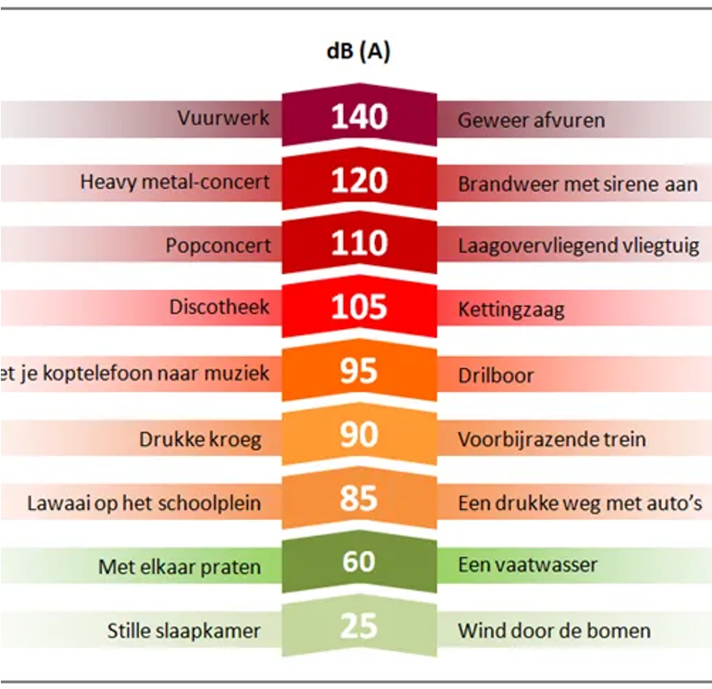
SOUND ENVIRONMENT:
Sound is of great importance to people. It can be very pleasant when it is nature or music, but annoying when it is loud and unwanted for long periods of time.
When sound is unwanted, we call it noise. Noise can also lead to health problems, such as high blood pressure.

Slide 4

Listen for 1 minute in silence. What sounds do you hear?

Slide 5
Which sounds make you concentrate well or enjoy doing homework?

Slide 6

NOISE IN HEALTHCARE:
Sound affects our well-being.
In healthcare, the effects of noise have long been underestimated. On the one hand, sound can have a negative impact on the well-being of patients and staff. On the other hand, sound can also have a stimulating effect and contribute to recovery.
Source: FMT Healthcare, 6-2013
https://www.youtube.com/watch?v=QBP89gsa-TA (2.47)

Slide 7
IMPACT OF NOISE IN HOSPITAL CARE:
A peaceful environment ensures better sleep and faster recovery
Sleep is fundamental to patient recovery. The World Health Organization (WHO) stipulates that for a good night's sleep, continuous background noise should not exceed 30 decibels. Previous studies on noise in hospitals around the world have shown that the average noise level is 60 decibels during the night and 70 decibels during the day.
Noise affects performance
There is a significant difference whether a complex task is performed in a quiet or noisy environment. In a noisy environment, execution is about 50% less accurate. Studies have found that average noise levels in emergency rooms and operating theatres often exceed 70 decibels.
Less noise - less medicine
In noisy environments, patients need medication more. A study in the cardiac care unit (CCU) showed that the number of patients with chest pain who needed beta-blockers decreased by 67% after the noise environment was improved.

Slide 8

SOUND ENVIRONMENT:
Hearing loss reduces quality of life
Age-related hearing loss (presbyacusis) affects about 37% of 61-70-year-olds, 60% of 71-80-year-olds and almost 90% of people over 90 years old.
Frequent communication problems and misunderstandings lead to withdrawal, self-doubt and depression. Impaired hearing also affects room orientation and increases the risk of falls.
Sound affects us all, but some more than others
The most familiar reaction to unwanted noise is annoyance.
People in whom cognitive ability deteriorates may not be able to place many unpleasant sounds, which can confuse them and even make them anxious.

Slide 9


Perception of care
Patients with experiences in both good and poor acoustic environments had more positive feelings about healthcare staff in good acoustic environments.
Less noise - less stress
A study on stress hormones showed that adrenaline levels increase by 43% after just three hours of exposure to low-intensity noise, compared to a quiet environment.

Slide 10


WHICH SOUNDS ARE PERCEIVED AS PLEASANT?
  Pleasant, homely sounds
  A familiar creaking house, the shower splashing, birds outside, rain on the roof tiles
  'safe', 'familiar' and 'relaxed'

Slide 11


WHAT IS BINAURAL OR NEURODIVERGENT MUSIC AND HOW CAN IT HELP?
Read the article on binaural beats HERE.
Listen to neurodivergent bilateral beats HERE.
Listen to super low frequency music HERE.

Slide 12
What could you do on your internship to become aware of one's sound environment?

Slide 13


CONCLUSION:
A good sound environment:
  Lowers blood pressure
  Improves quality of sleep
  Reduces the need for pain medication
  Enables better communication
  Lowers stress levels
  Improves patient safety
  Improves well-being, performance and job satisfaction of care staff
Next lesson, we will talk about the activities you can apply!

Slide 14






ASSIGNMENTS:
For this lesson, complete assignments 1, 2 & 3 from lesson 3.

