Slide 1


LESSON 4
Music in care
  Lesson 4 - Using music

Slide 2


EVALUATION PREVIOUS LESSON:
Sound environment

Slide 3
REFLECTION ASSIGNMENT 1 CASE STUDY MRS. JANSEN
Mrs. Jansen is sitting at the communal dining table. She is very restless and refuses to eat. Mrs. Jansen has been diagnosed with Alzheimer's disease for 5 years and has been living in the nursing home for 1 year because she can no longer live independently. Mrs. Jansen has always lived in the countryside between 2 farms; she had her own house here and lived alone for the last 10 years after her husband passed away. She was never a farmer herself, but she always enjoyed the sound of birds and cows.
She hears the nurses talking at a table behind her; they are on a break. In the kitchen, the plates are being washed for the people who have finished eating. BEEP, BEEP, BEEP... "What is that?!" She sees the nurse walk past again. BAM! "Oh, I don't know anymore." "Mrs., you need to eat something, shall I help you?" "NO, I don't want anything..." and she knocks the plate off the table. Mrs. Jansen is covered in macaroni. "It's not working, I DON'T WANT TO!" Mrs. Jansen says.
Why do you think Mrs. Jansen doesn't want to eat?
What would you do in this situation?

Slide 4
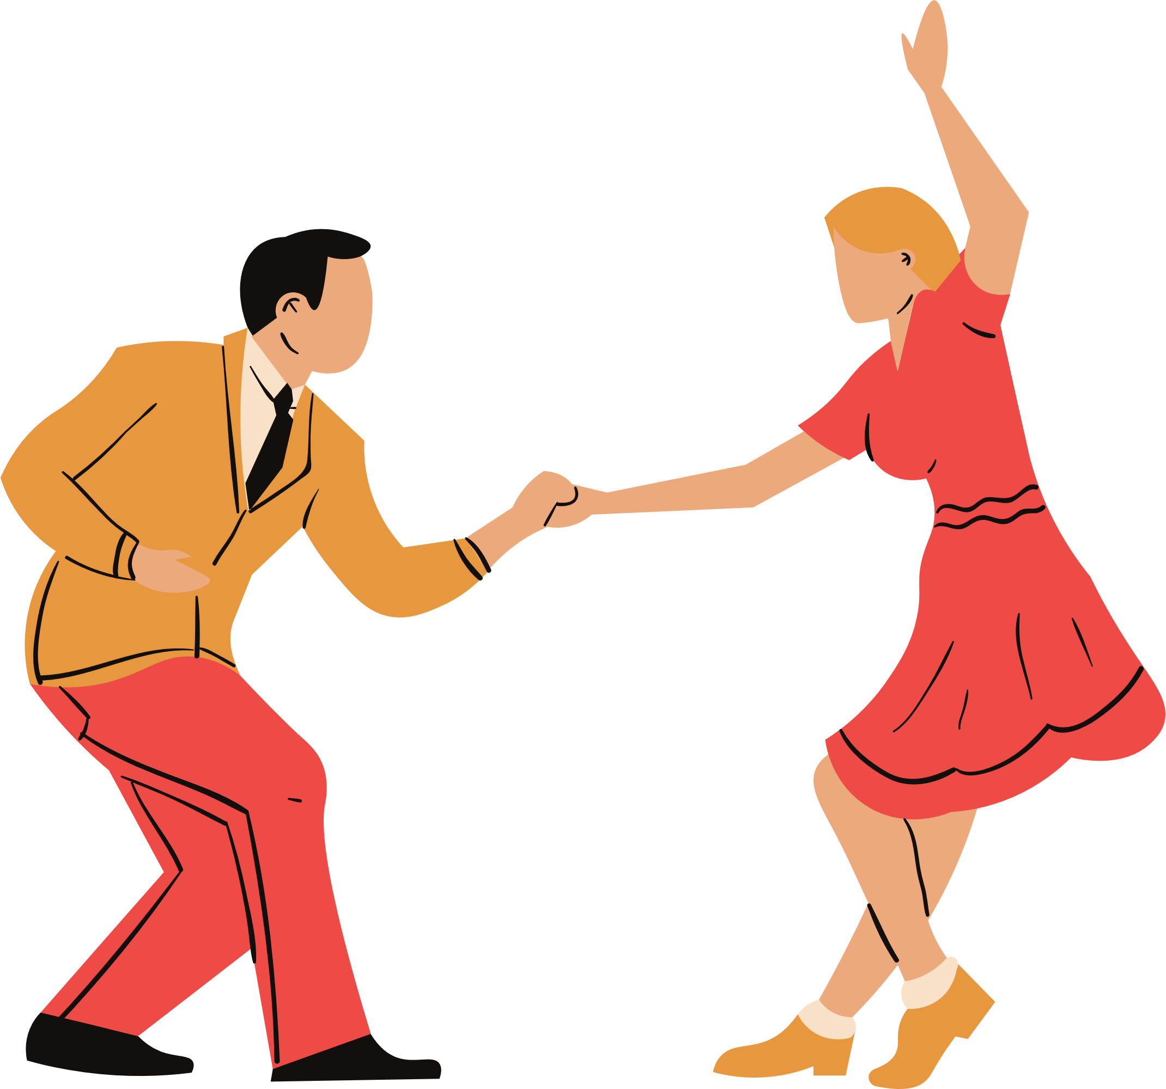
REFLECTION
ASSIGNMENT 2: A music activity
Have you ever seen a music activity at your work (in healthcare), during your internship, or when visiting your grandparents in the care home?
  What kind of music activity was this? (Describe the situation)
  Was this in a group or individual setting?
  How did the care recipients react to this activity?
  What did you think of this activity?
  What music activity would you like to do with care recipients?

Slide 5
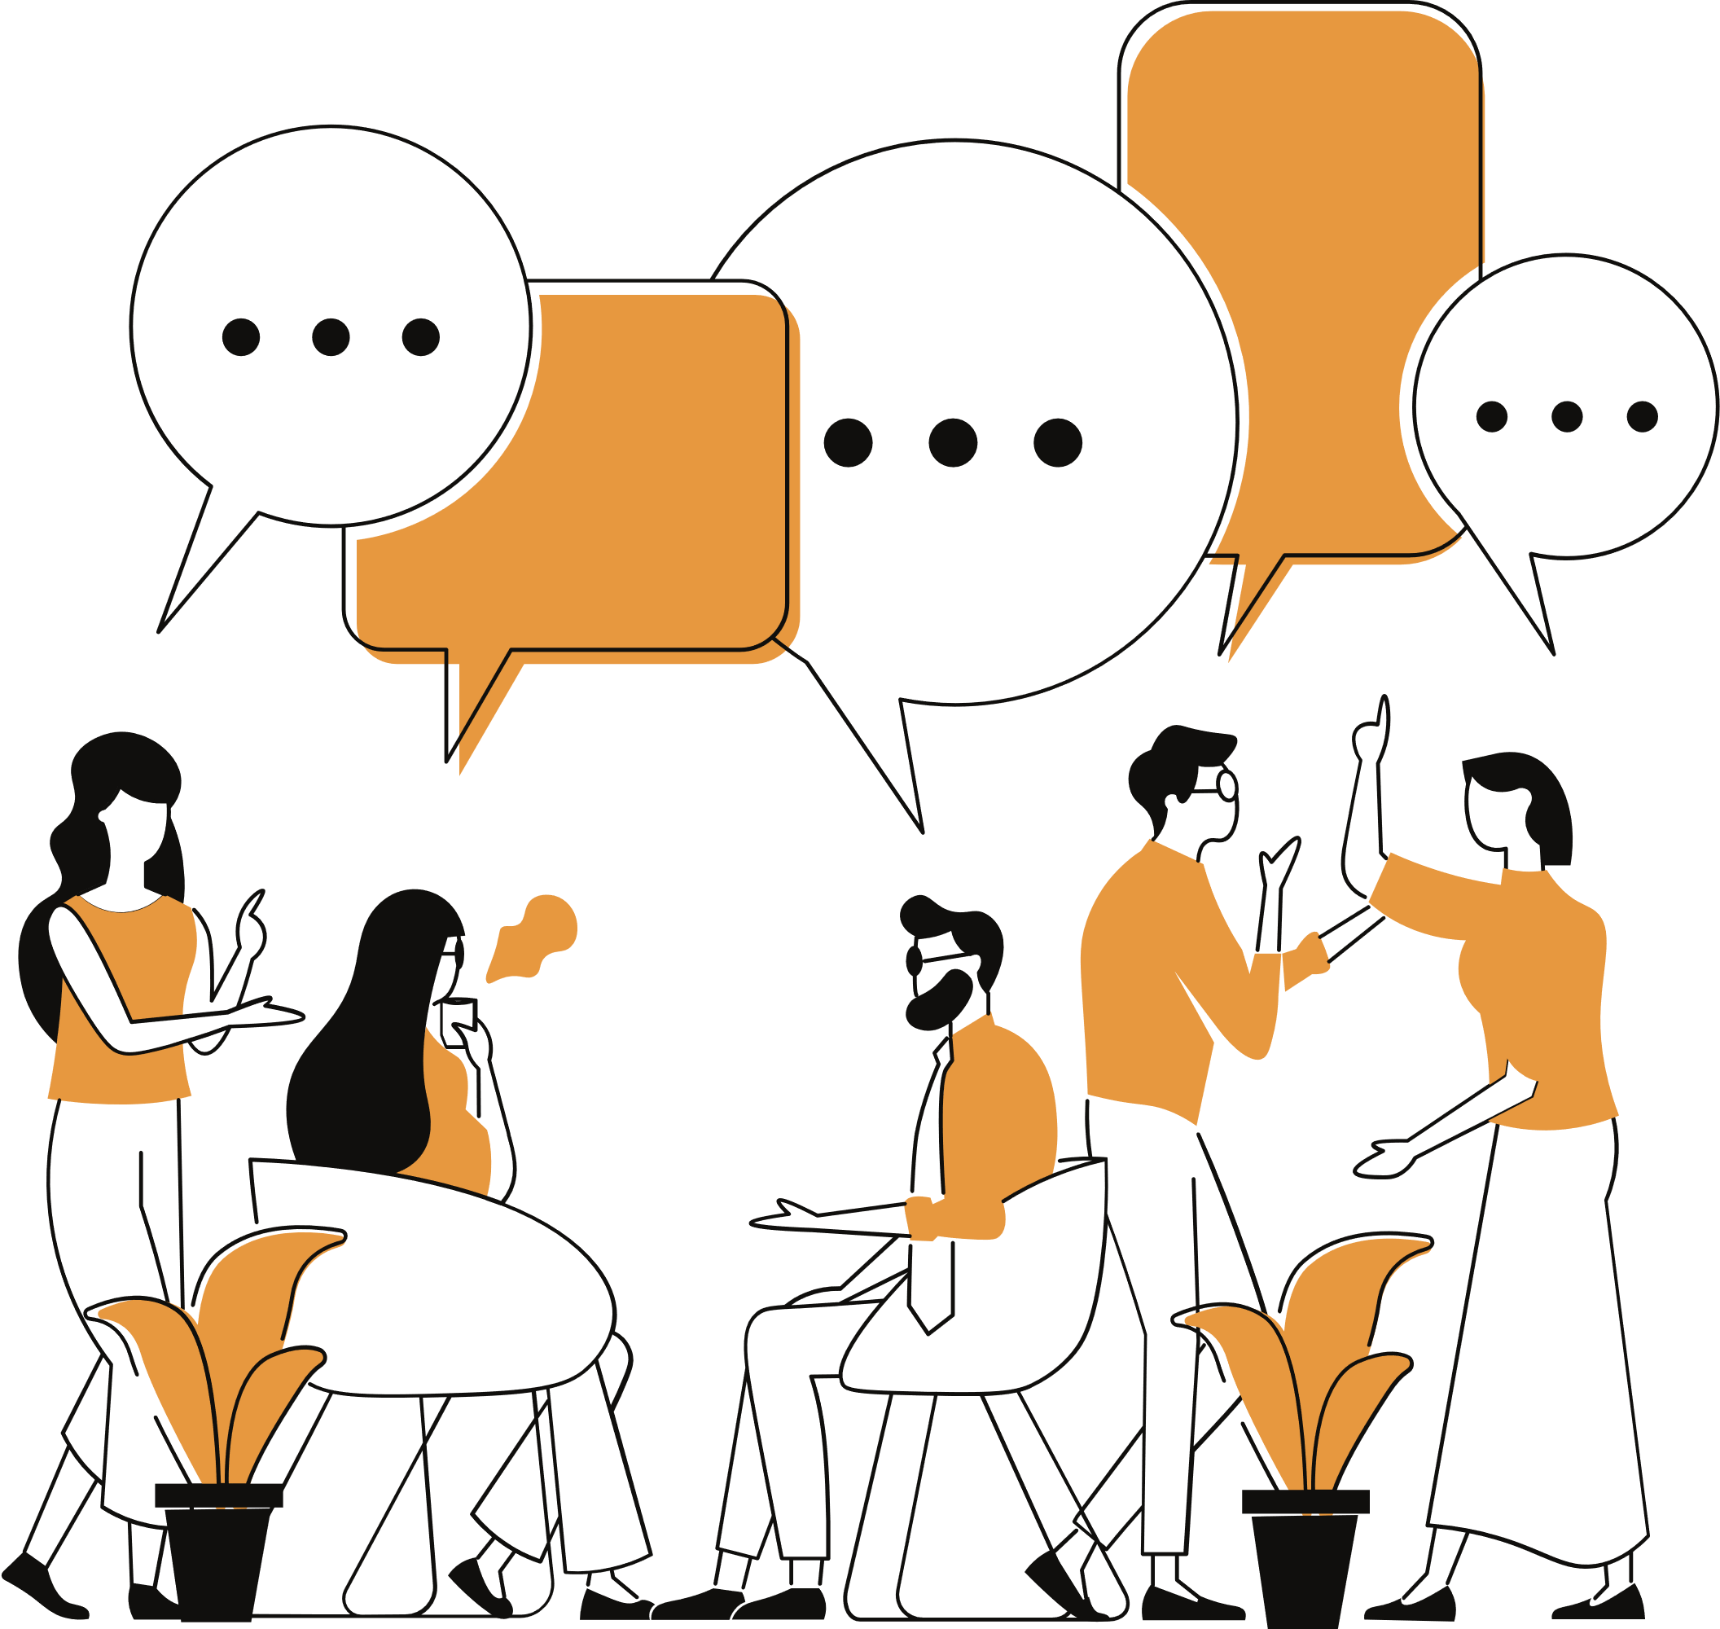
QUESTION:
I would like/dare to apply music within healthcare.

Slide 6
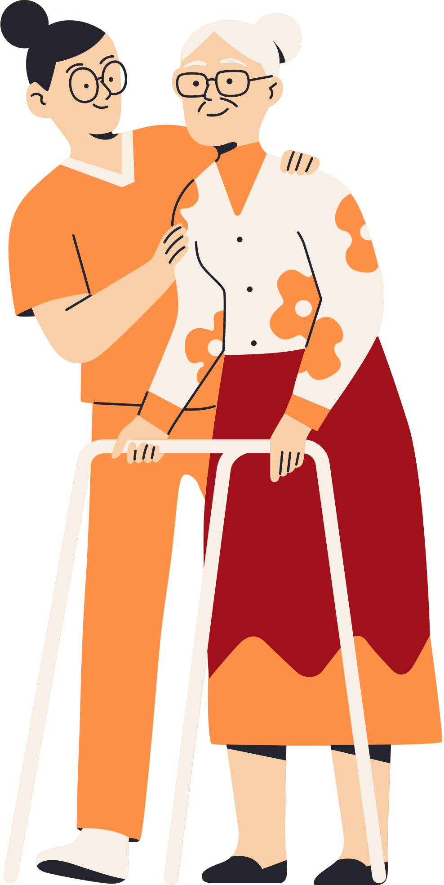

QUESTION:
When we talk about behavioural problems within healthcare, what do you think of?

Slide 7
CASE STUDY JORIS IS AGGRESSIVE
Joris lives within small-scale living for people with non-congenital brain injury. Joris is 23 years old and was involved in a serious car accident when he was 15. His brain has become damaged as a result, so he can no longer communicate well with the outside world. Speaking is no longer possible but showing his emotions is fine.
Generally, Joris smiles a lot but in recent weeks, Joris is increasingly angry and sometimes even aggressive when he is in the common living room where a country play list is on for an average of 2 hours every day. Henk (a group member) loves country music and regularly tries to sing along.
  What could be the cause of Joris' behavioural problems?
  What investigations could you do to confirm these possible causes?
  What actions could you put in place so that you meet the needs of multiple caregivers within the group?

Slide 8


ENERGISER MUSIC AND RECOGNITION
  Make sure the youtube video is visible on the screen or not if you want to make it difficult
  Music and artists
  Have students keep track of their scores.
Click here for the link to the video

Slide 9
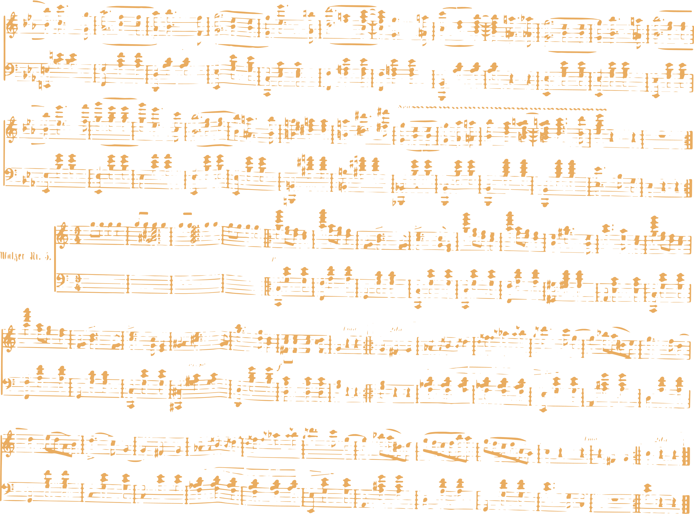


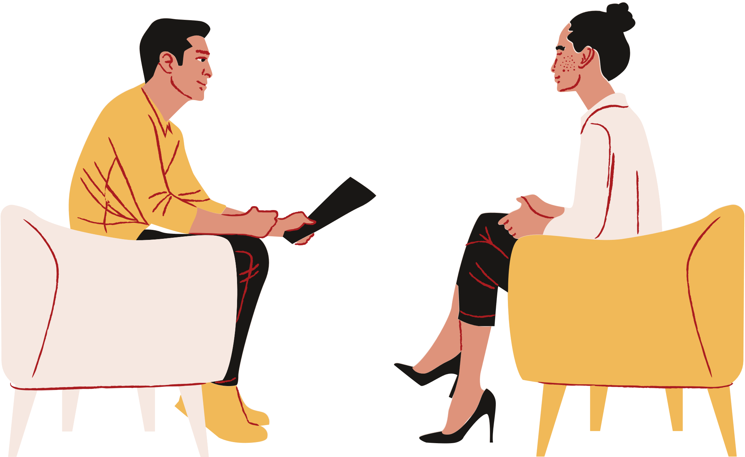


ASSIGNMENTS:
For this lesson, complete assignments 1, 2 & 3 from lesson 4.
EVALUATIE:

