Slide 1


LESSON 6
Music in care
  Lesson 6 - Music therapist

Slide 2
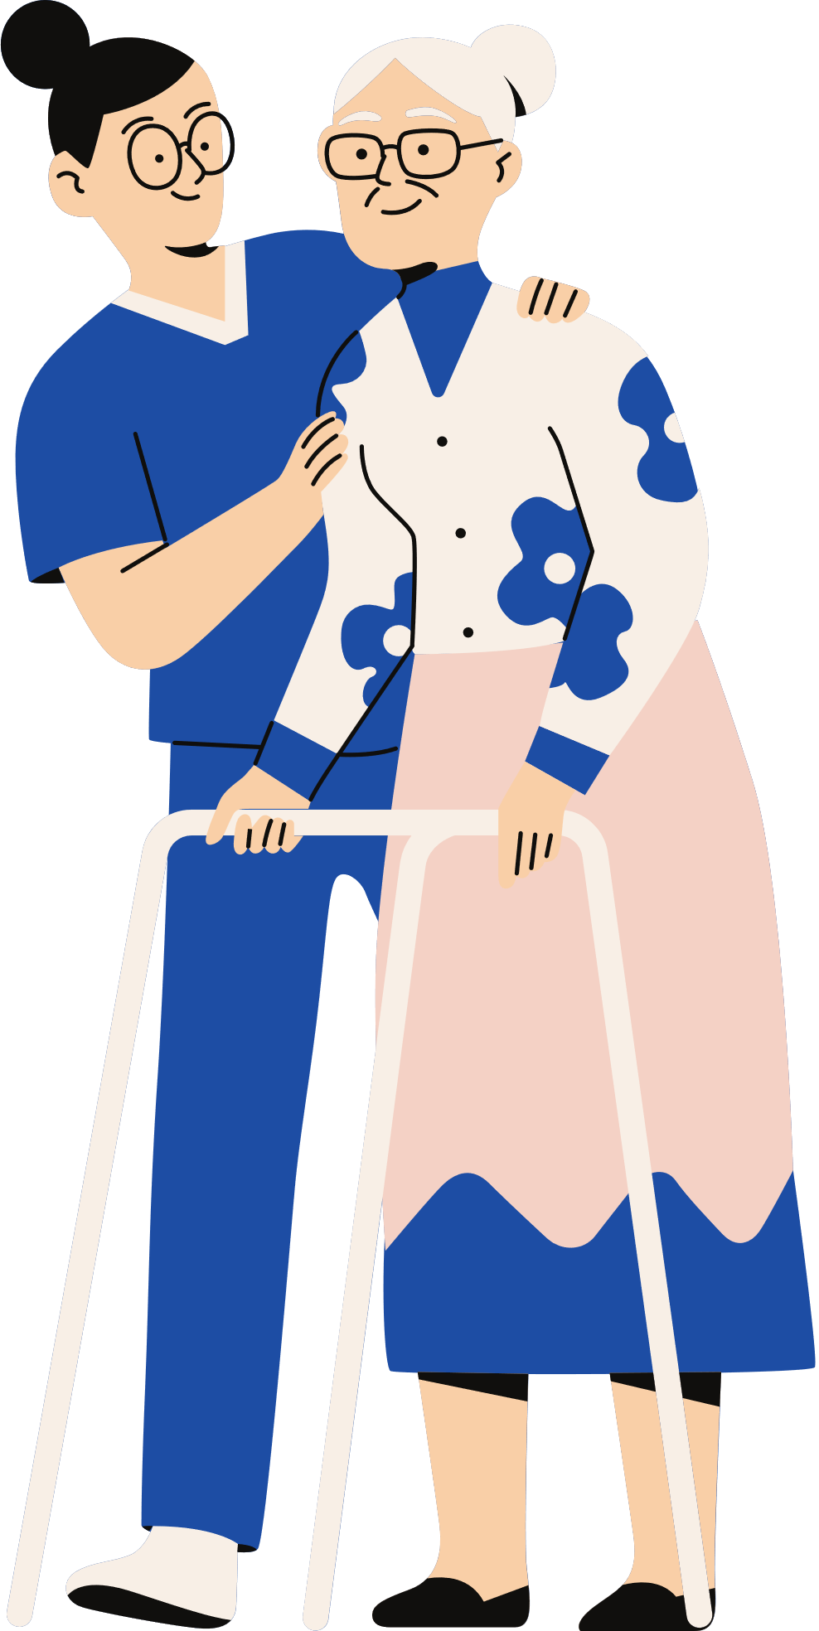
EXPRESSIVE THERAPY
  A way of treatment that emphasizes doing and experiencing.
  Treating psychosocial and psychological problems.
Reason for choosing expressive therapy:
Working on problems in a different way alongside regular care.
It is important for recovery because the focus is not on talking but experiencing

Slide 3
Form of expressive Therapy | Brief explanation
Art therapy | Art therapy involves methodical work with targeted interventions using visual materials, tools and techniques, e.g. painting, drawing, textiles, metal, stone, wood and digital means
Dance therapy | Dynamic movement interactions such as improvisation, synchronisation, relaxation, dance and play are used methodically and purposefully.
Drama therapy | In drama therapy, methodical work is done with a fictional reality through drama and theatre work forms, drama therapy play, scene work (fictional play), role play and psychodrama techniques such as role reversal and rescripting.
Music therapy | Music therapy involves methodical work with the elements of music, such as melody, rhythm, harmony and text.
Psychomotor therapy | Psychomotor therapy uses interventions that focus on body perception and movement behaviour
Psychomotor pediatric therapy | Targeted interventions using occupational therapy resources best suited to the individual child, e.g. body-based play, movement and play materials, musical, sensory and creative resources.
Play therapy | A form of psychotherapy for children, using play as a means of understanding and helping a child. Play is the language of the child.

Slide 4
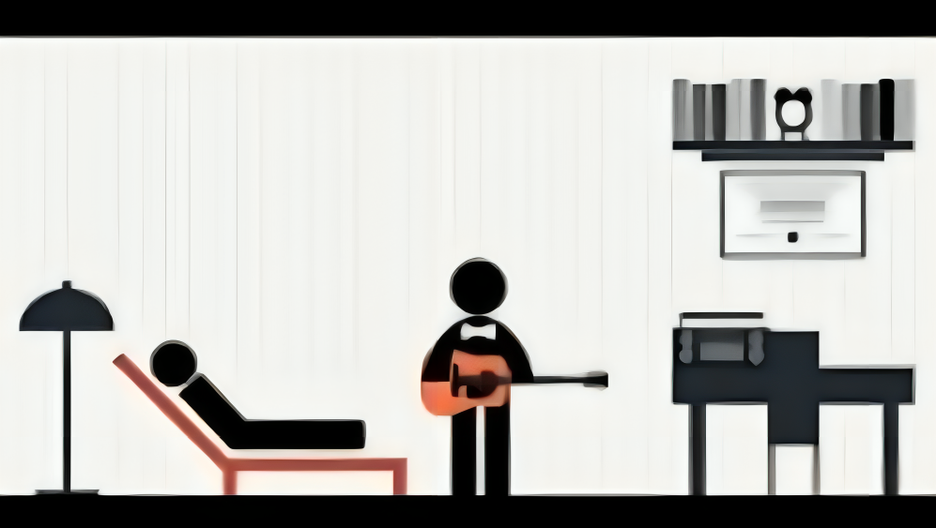
MUSIC THERAPY

Slide 5
FOCUS OF CARE
Patients and loved ones indicate that patients often want to use music therapy primarily for:
  increasing well-being and regulating their emotions
  expressing thoughts and feelings, standing up for their own needs, learning to make their own choices.
  regulating tension.
  Complaint-oriented: care demand is the starting point
  Person-centred: extra attention to success and strengths of patient.
By gaining experiences during music therapy, patients learn to translate them into everyday life. Learn to cope better with emotions, tensions, and motor skills that get in the way of self-management.

Slide 6
PERSON-CENTRED APPROACH AND WELL-BEING
Psychological well-being in particular is thought to contribute to the prevention and reduction of mental illness. ®Westerhof, G.J. & Keyes, C.L.M. (2008) p. 810.
Several factors affect psychological well-being:
Self-acceptance:
Acknowledging and accepting yourself, feeling positive about life so far
Personal growth:
Development, openness to new experiences, sense of effectiveness
Purpose in life:
Having direction in life, experiencing past as meaningful, beliefs that give life direction.
Environmental management:
Feeling able to deal with complex environment, choosing or creating environment that suits you
Autonomy:
Independent, self-determination, resisting social pressure, self-evaluation.
Positive relationships:
Having warm, confidential relationships, showing interest in others, empathy, affection, intimacy, give and take in relationships.

Slide 7
CONTRIBUTION OF EXPRESSIVE THERAPY
®Smeijsters, H. (2010) Practice research on interventions. Vaktherapie in Just-Juvenile Institutions and Closed Youth Care Tijdschriftvoor vaktherapie 6(1), 9-17
With expressive therapy, the patient can develop some of the positive, protective factors of psychological well-being, such as:
  setting your own goals
  self-actualisation
  trying out new roles
  mutually positive affirmation
  working on the basis of strengths
  gaining positive emotions
  new opportunities
  developing confidence in one's own ability to act
  enhance problem-solving capabilities
  directing situations

Slide 8
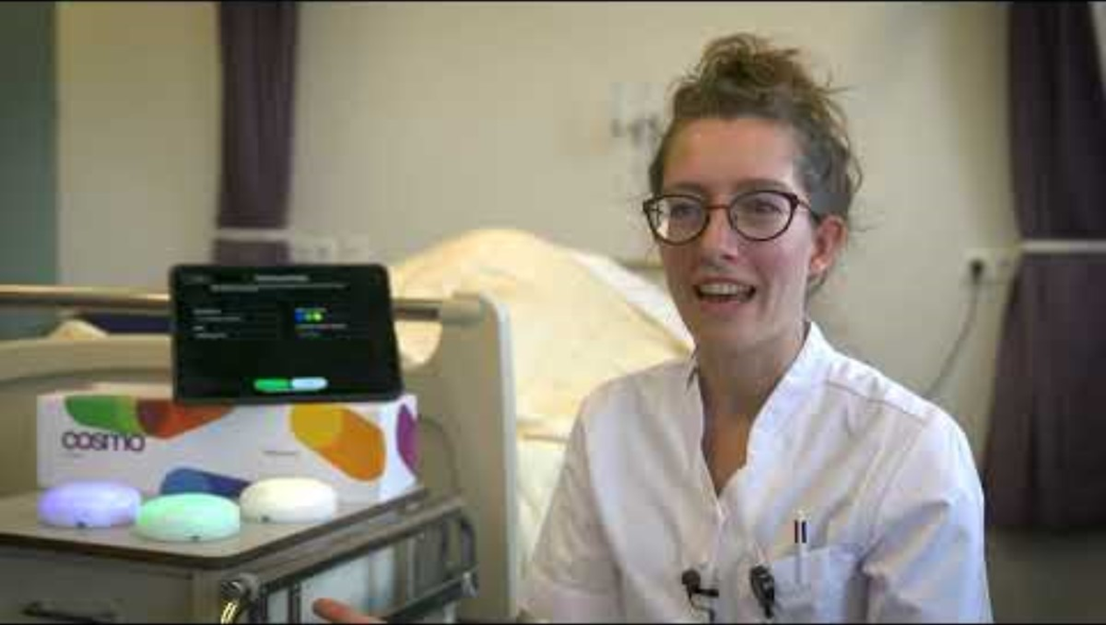
APPLIED IN THE NEUROLOGY DEPARTMENT
Watch the full video HERE.

Slide 9
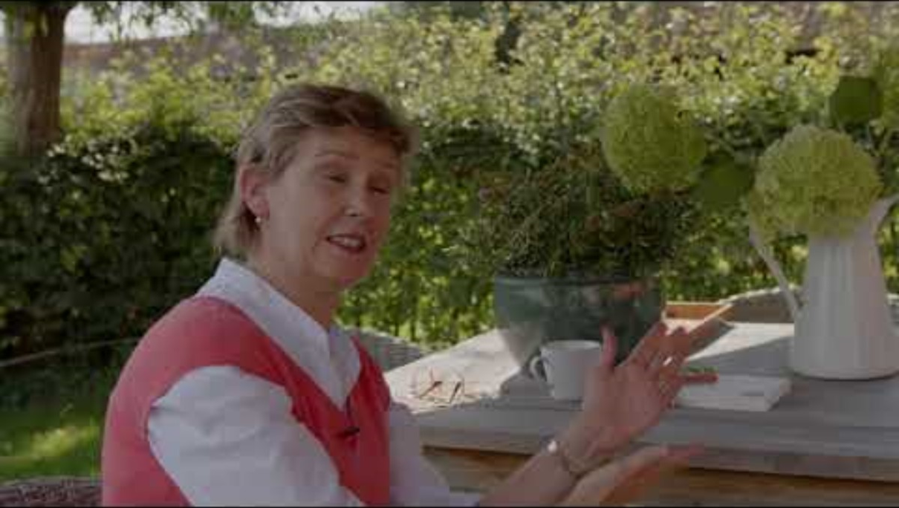
PARKINSONS AND MUSIC THERAPY
Watch the full video HERE.

Slide 10
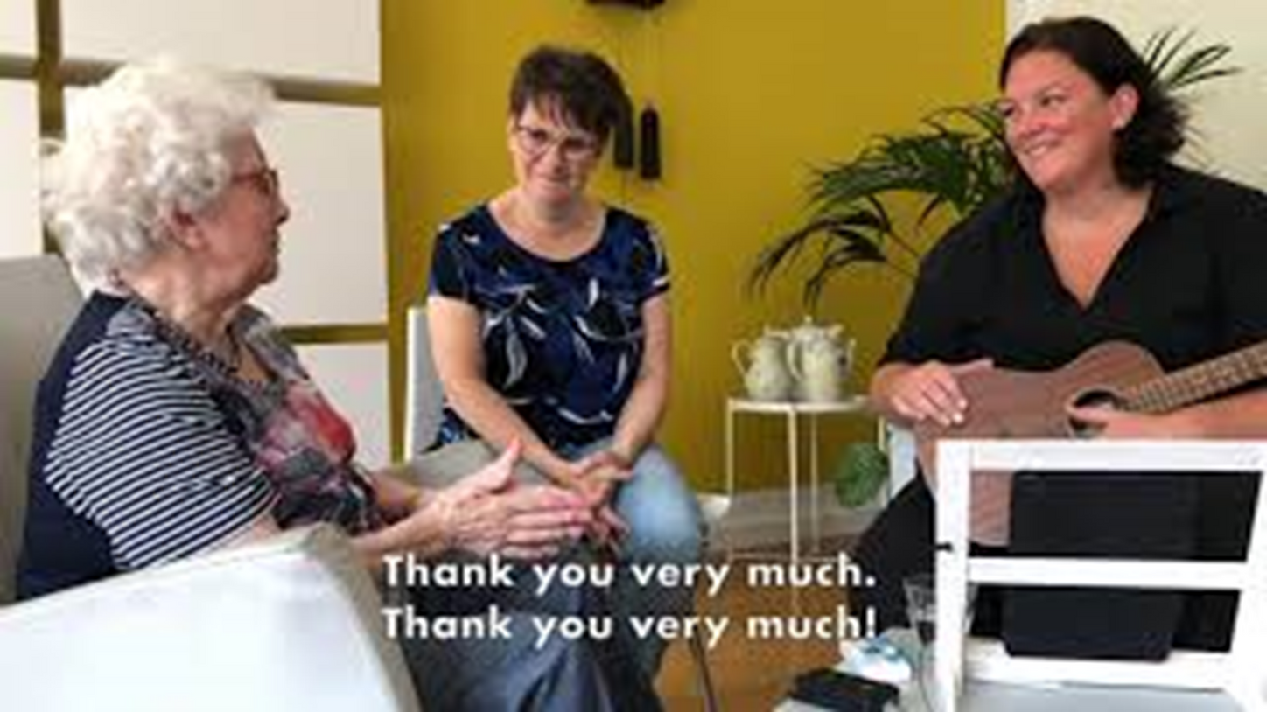
MUSIC THERAPY FOR DEMENTIA & CARERS
Watch the full video HERE.

Slide 11



ASSIGNMENTS:
For this lesson, complete assignments 1 & 2 from lesson 6
SOURCES
https://www.ggzstandaarden.nl/generieke-modules/vaktherapie/introductie

